Slide 1

Poster / Afiche
18 in

Slide 2
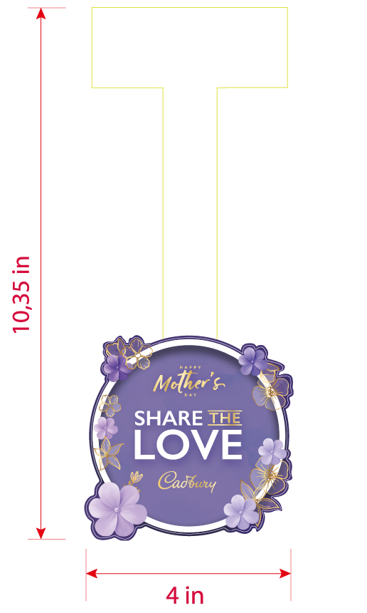
Wobbler / Dangler

Slide 3
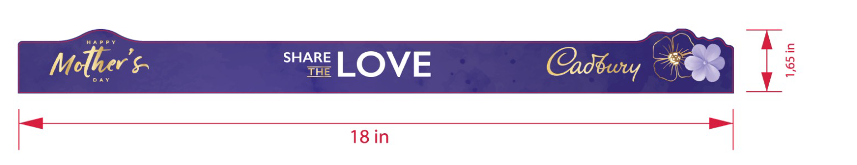
Shelf Strip

Slide 4
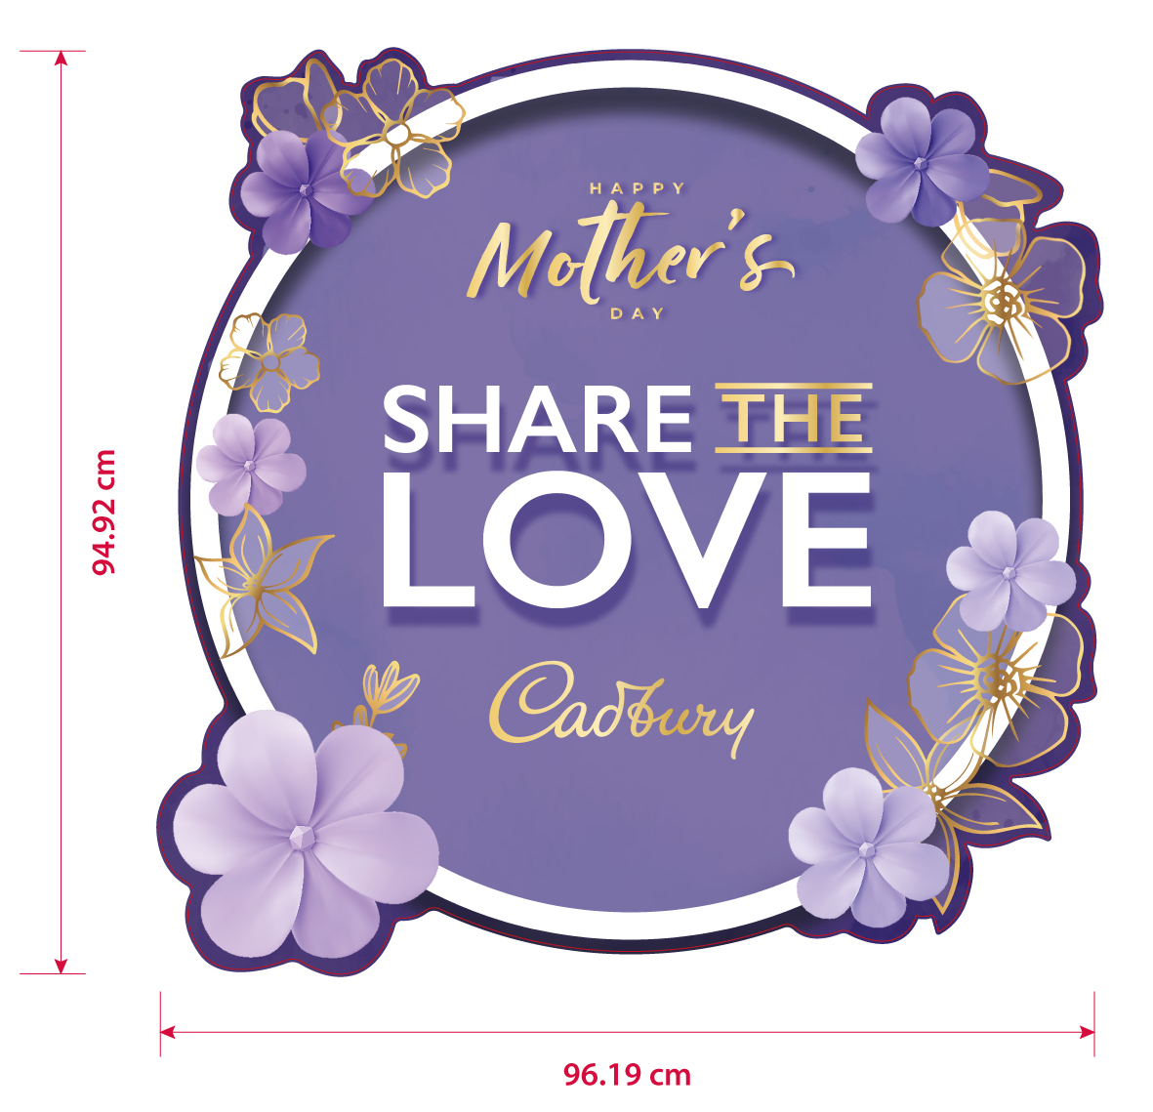
Floor sticker

Slide 5
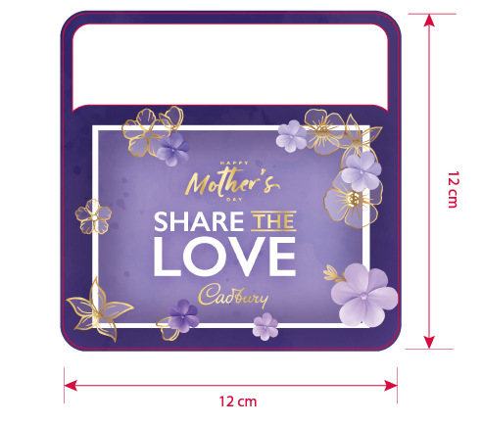
Price talker

Slide 6

Stopper

Slide 7
End Cap

Slide 8
Arco

Slide 9
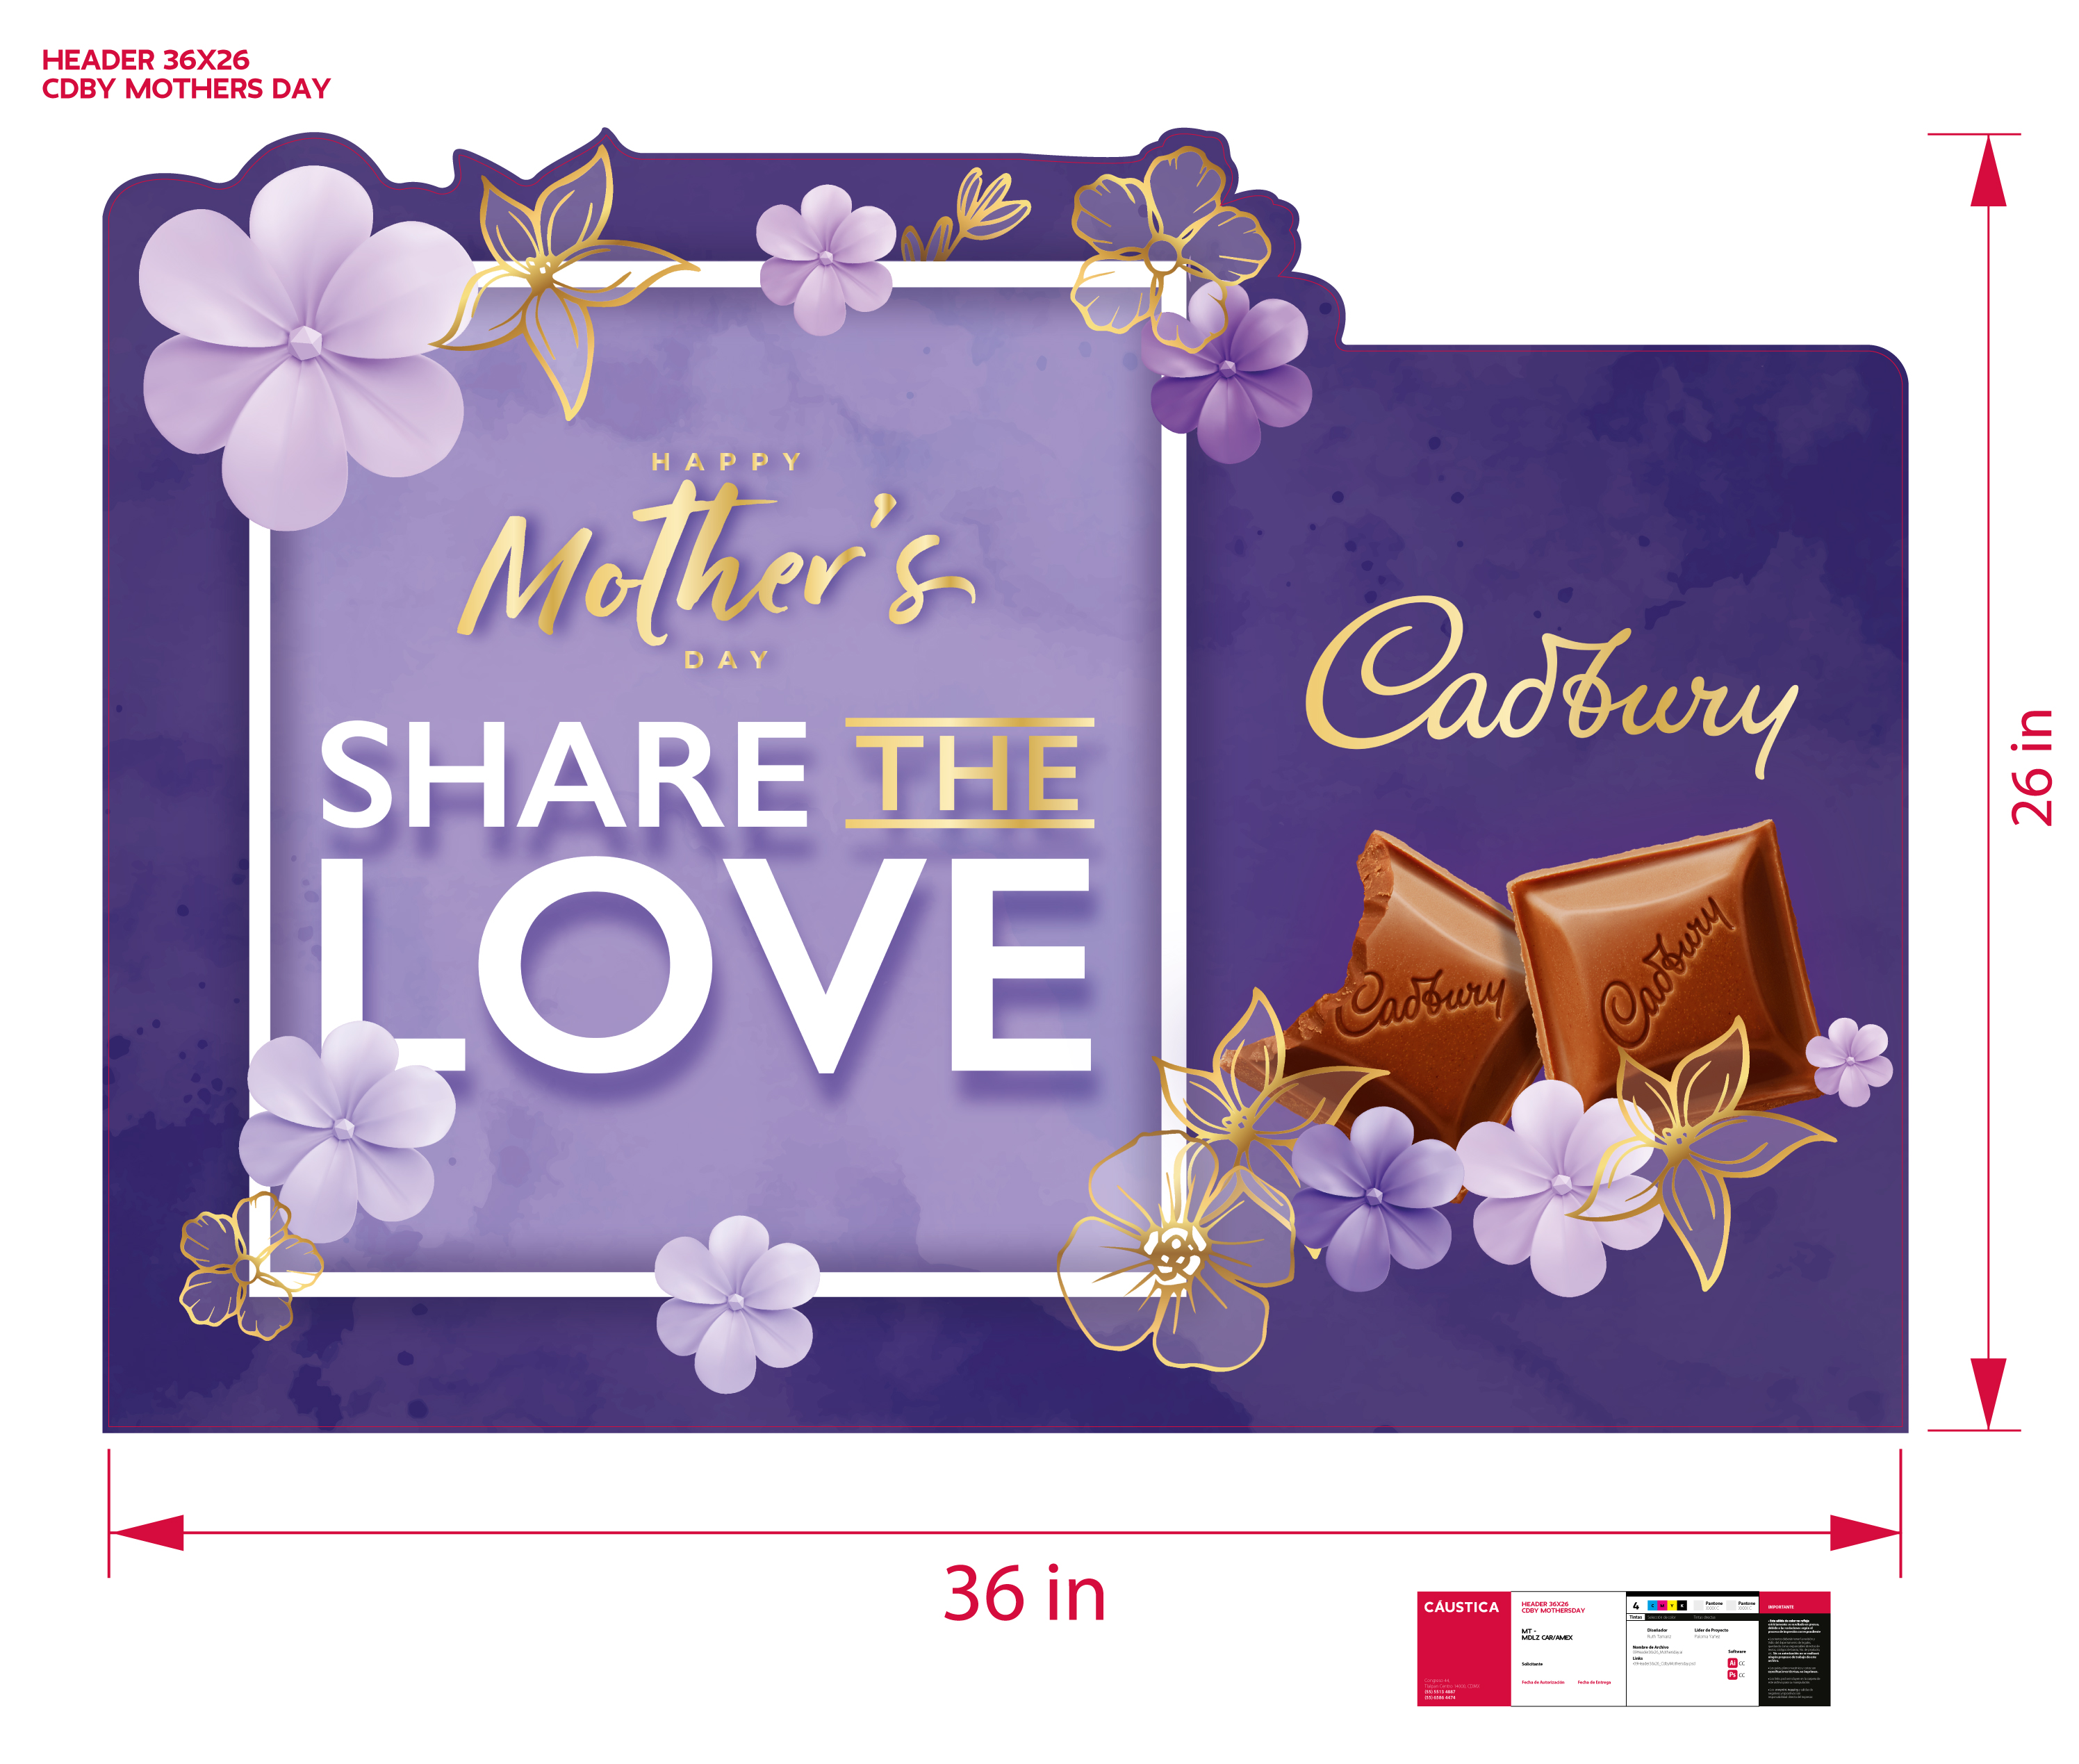
Header 36 x 26 in

Slide 10
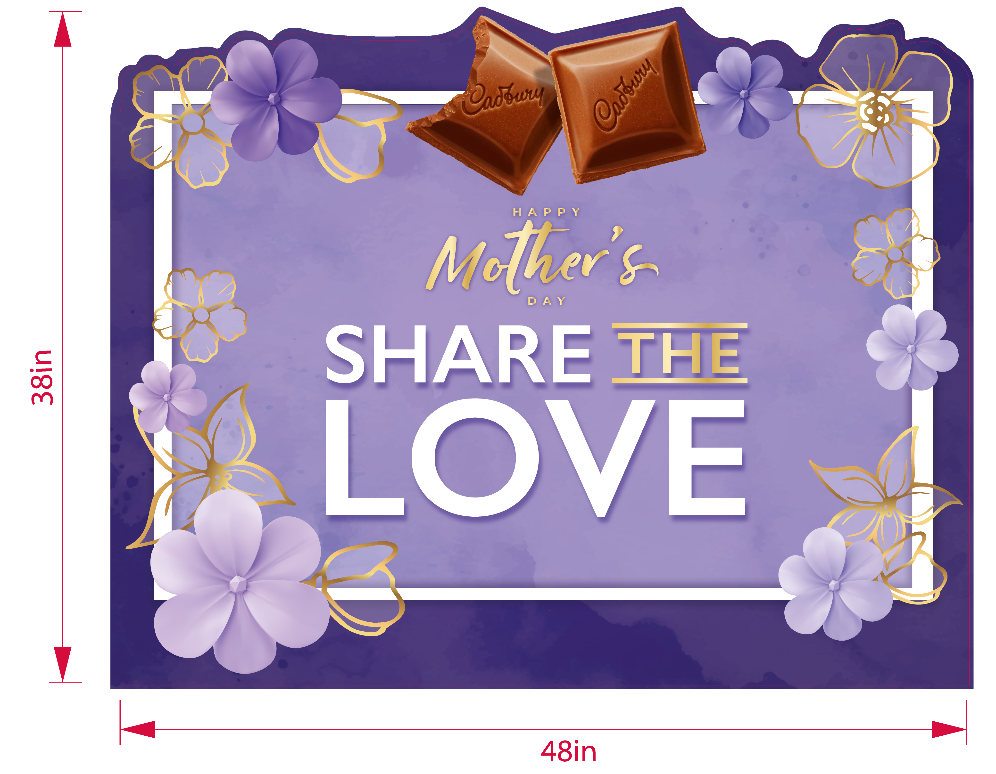
Header 48 x 38 in

Slide 11

Side panel

Slide 12

Mojito

Slide 13
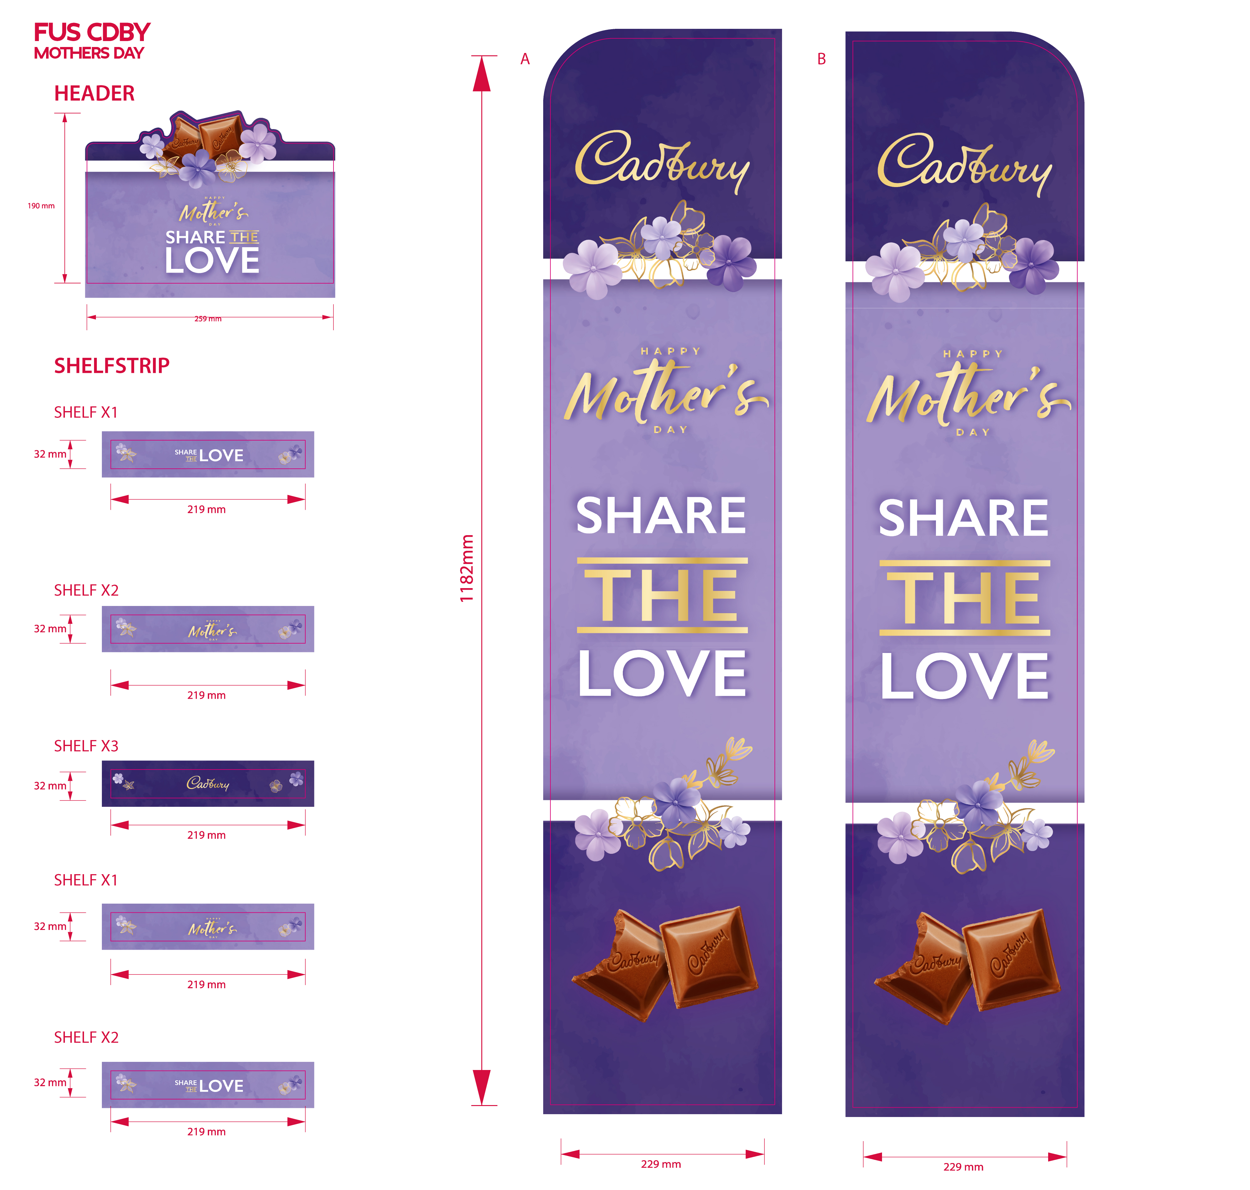
Figther Unit Slim

Slide 14
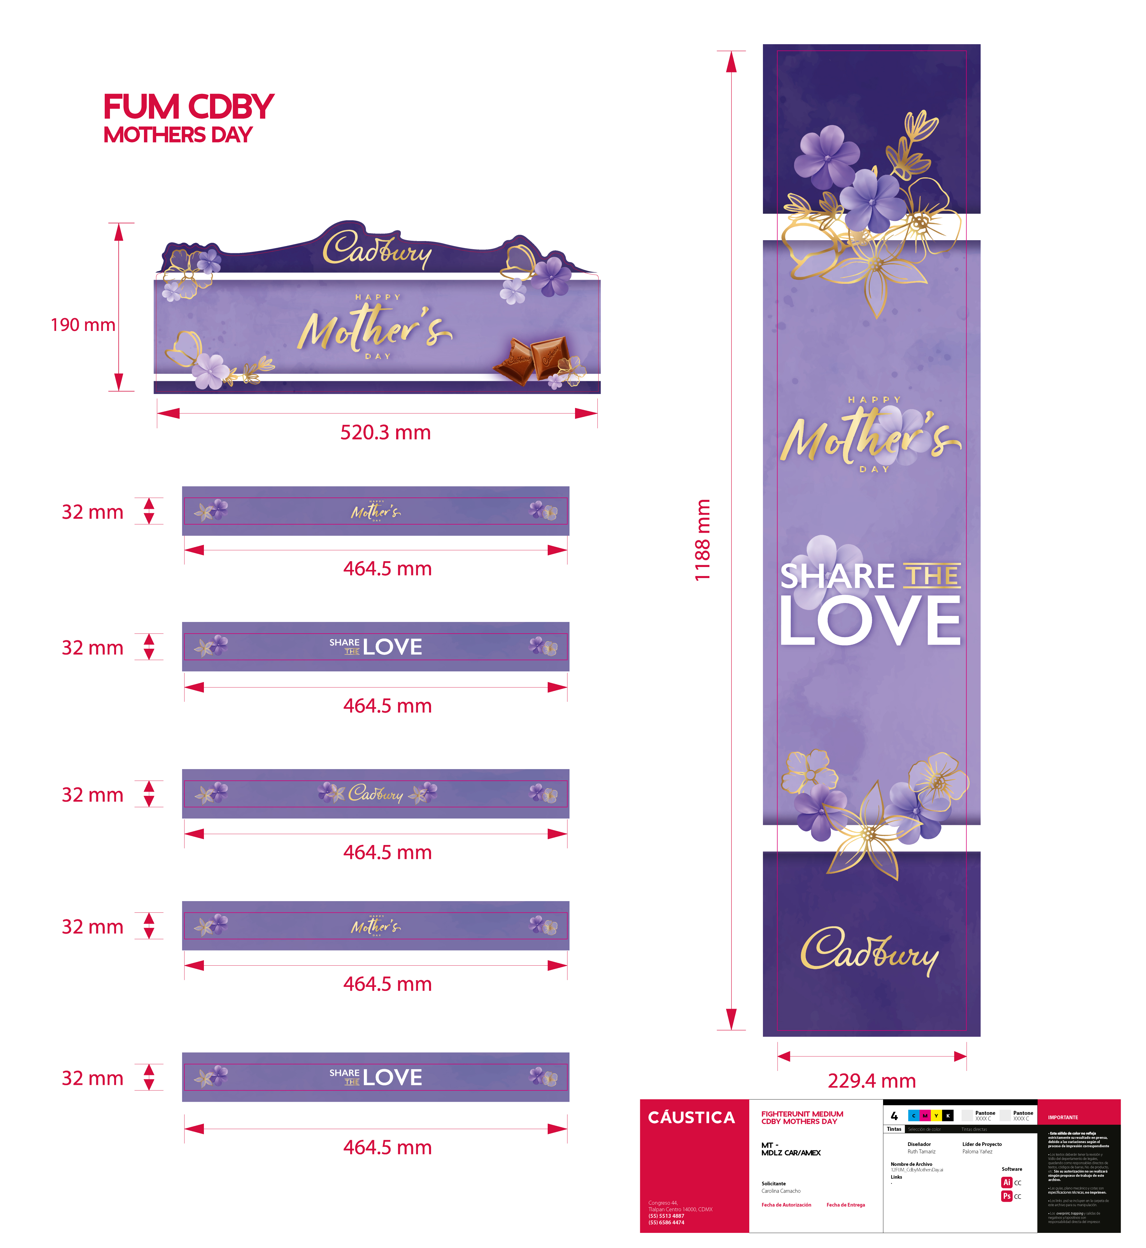
Figther Unit Medium

