Slide 1
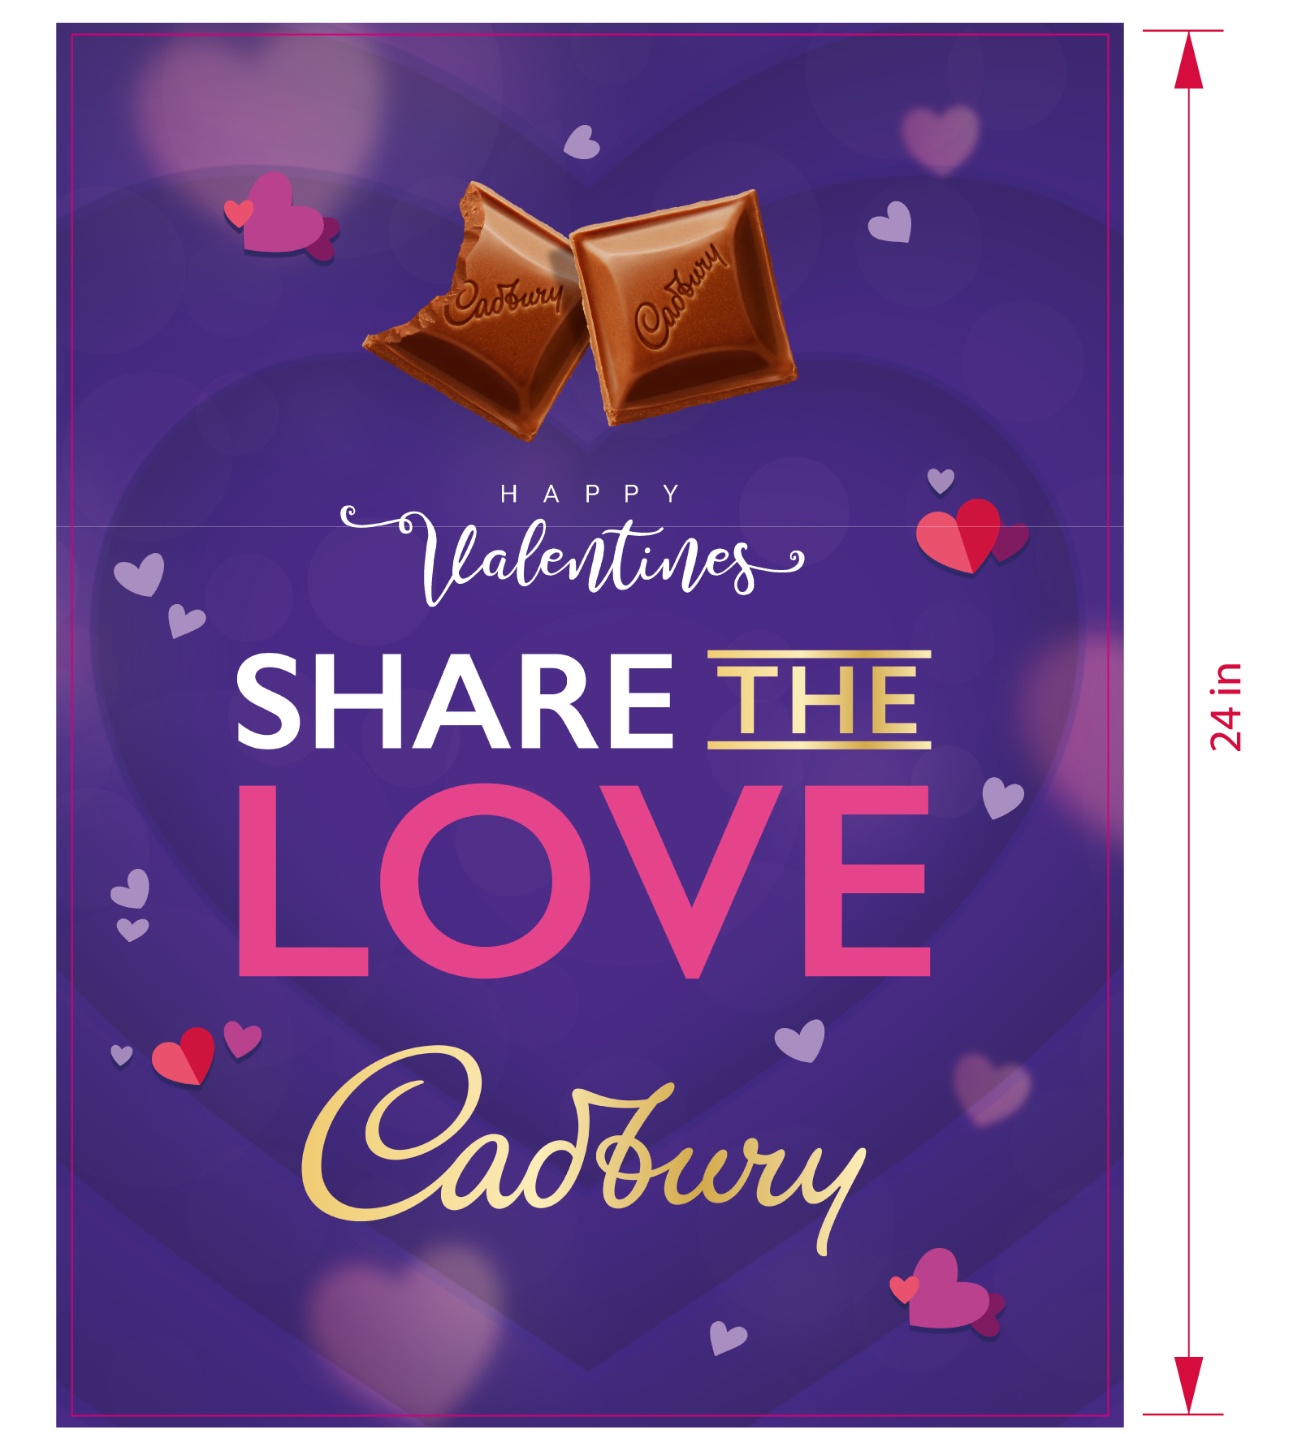
Poster / Afiche
18 in

Slide 2
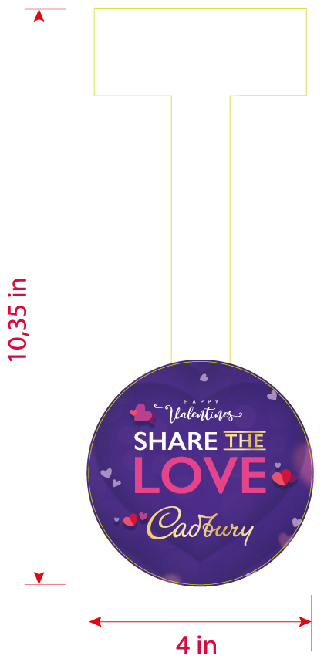
Wobbler / Dangler

Slide 3

Stopper
6.5 in

Slide 4
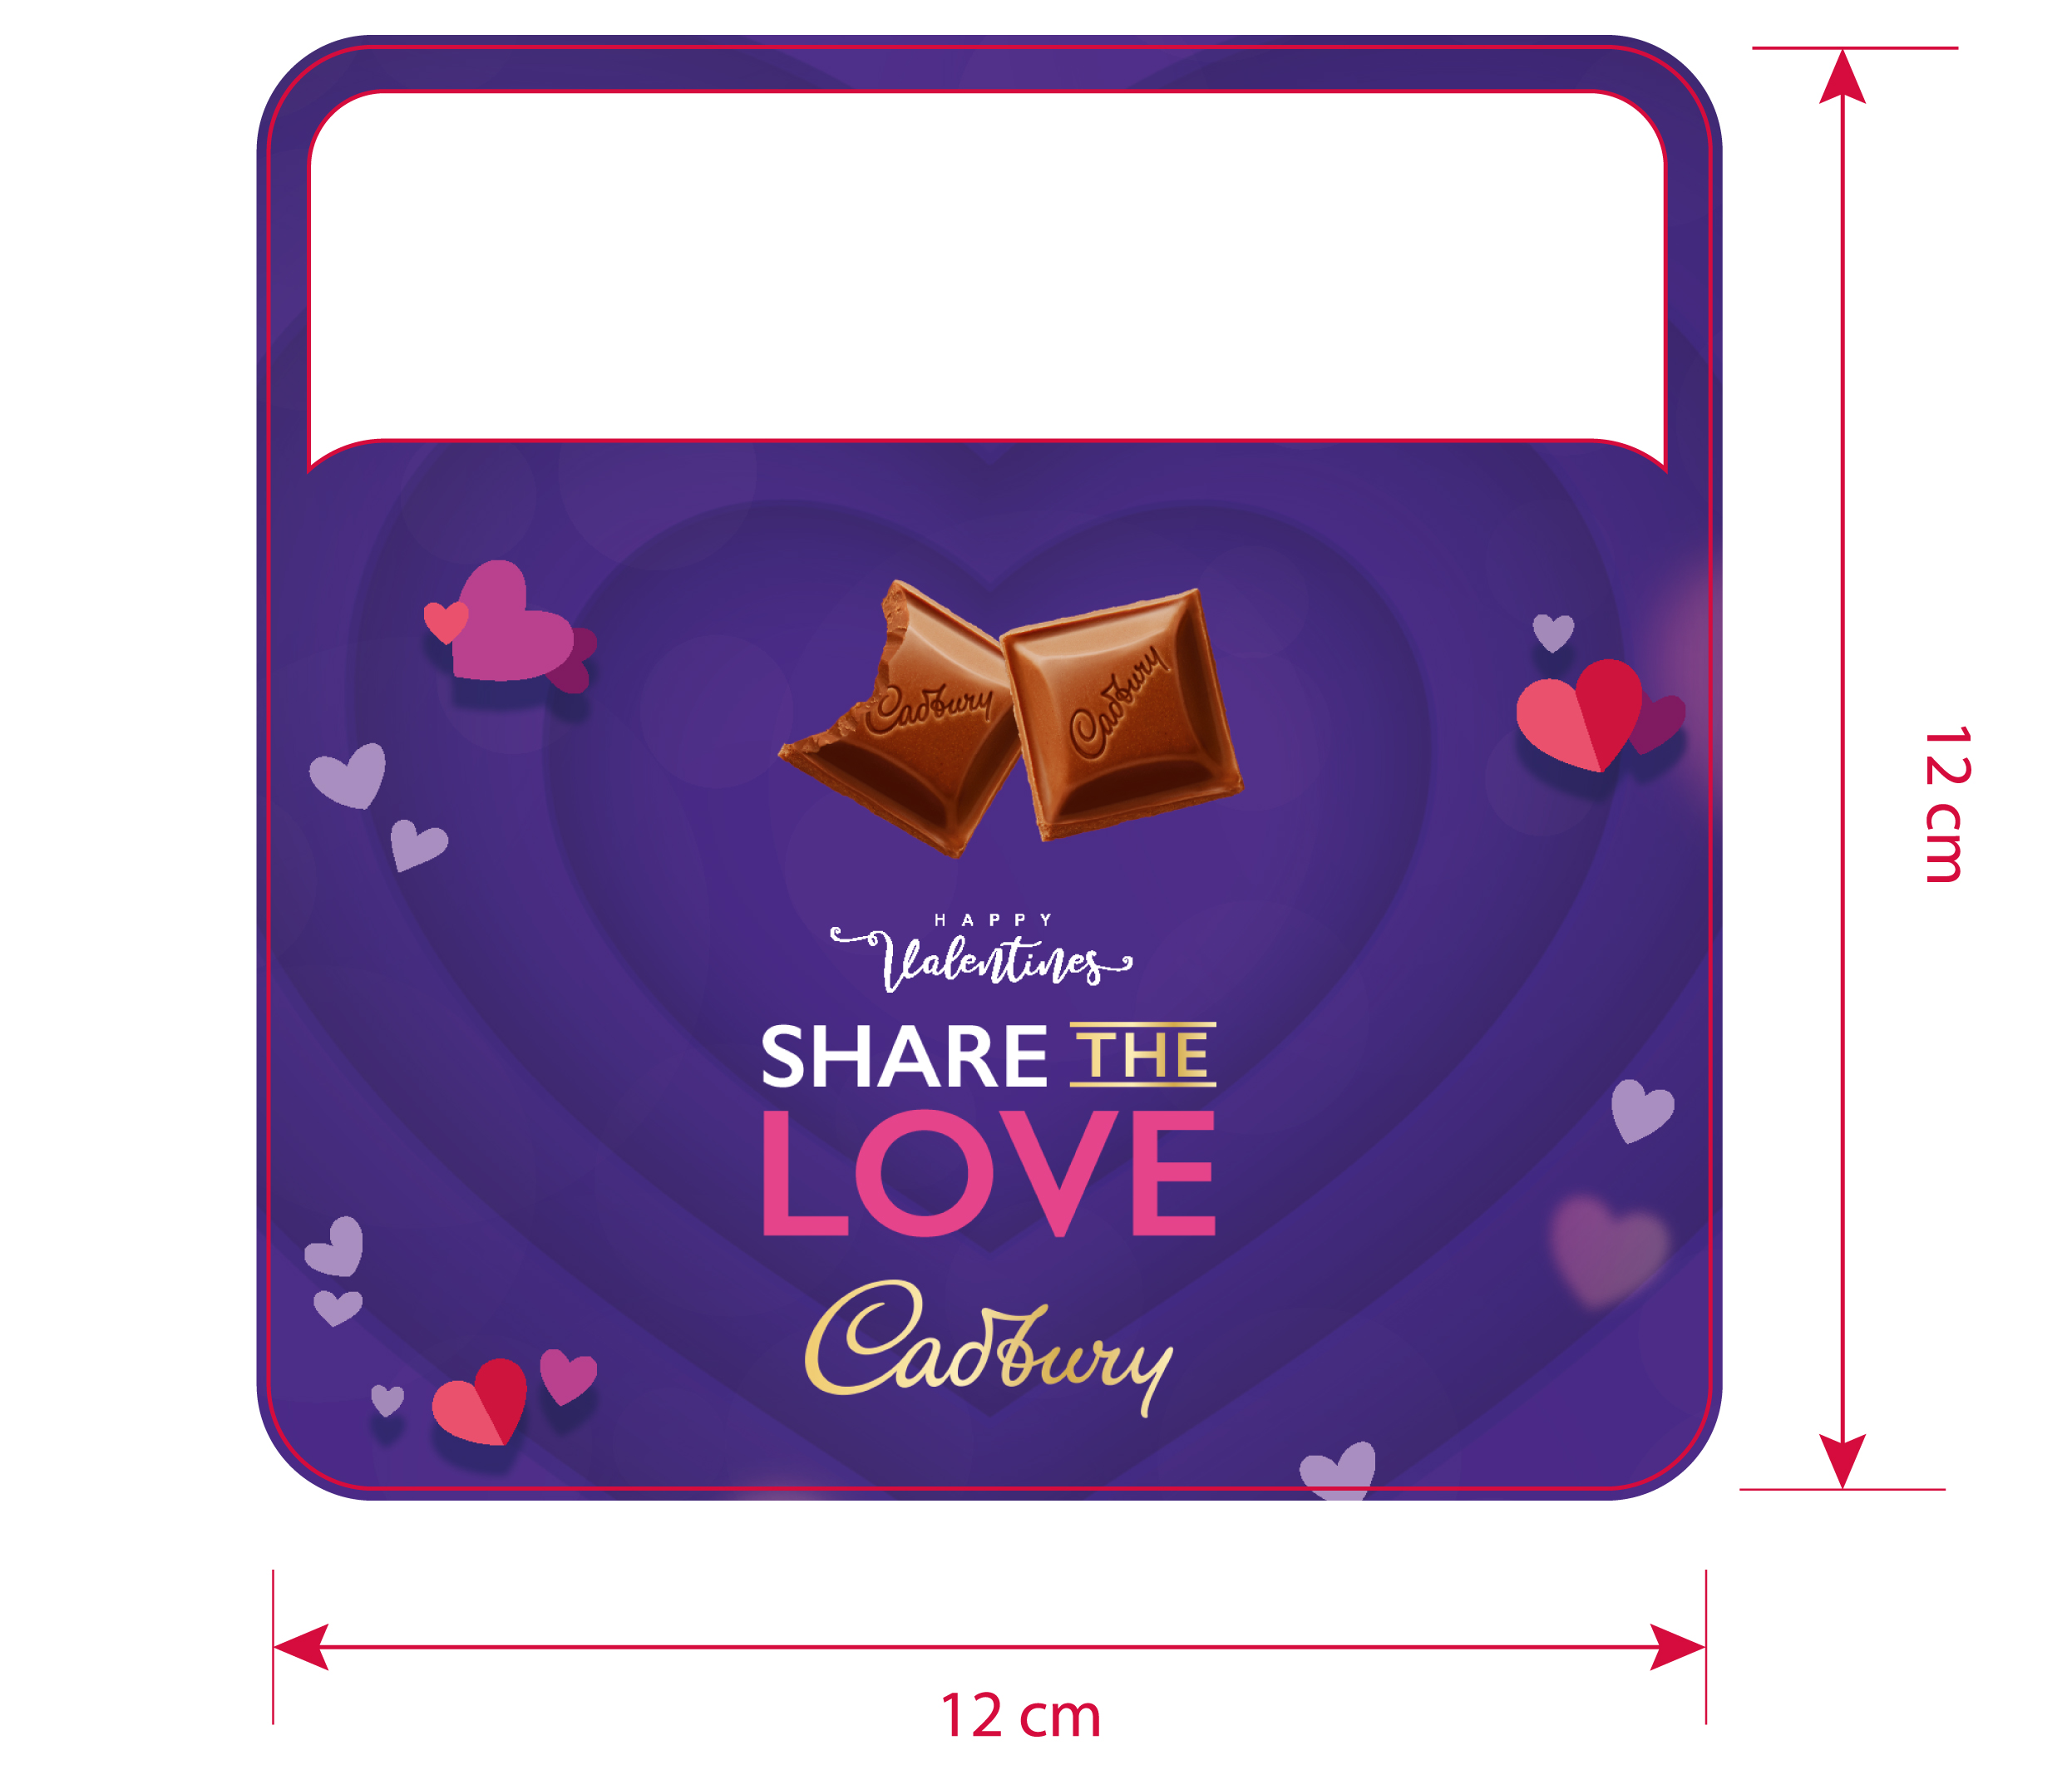
Preciador

Slide 5

Floor Sticker

Slide 6
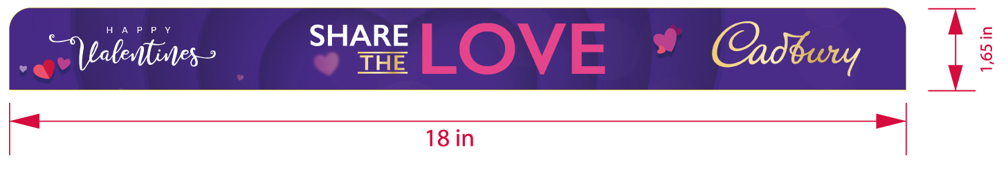
Shelfstrip

Slide 7
Arco

Slide 8

Side panels

Slide 9

Header 48 x 38 in

Slide 10

Header 36 x 26 in

Slide 11
End Cap

Slide 12

Mojito

Slide 13
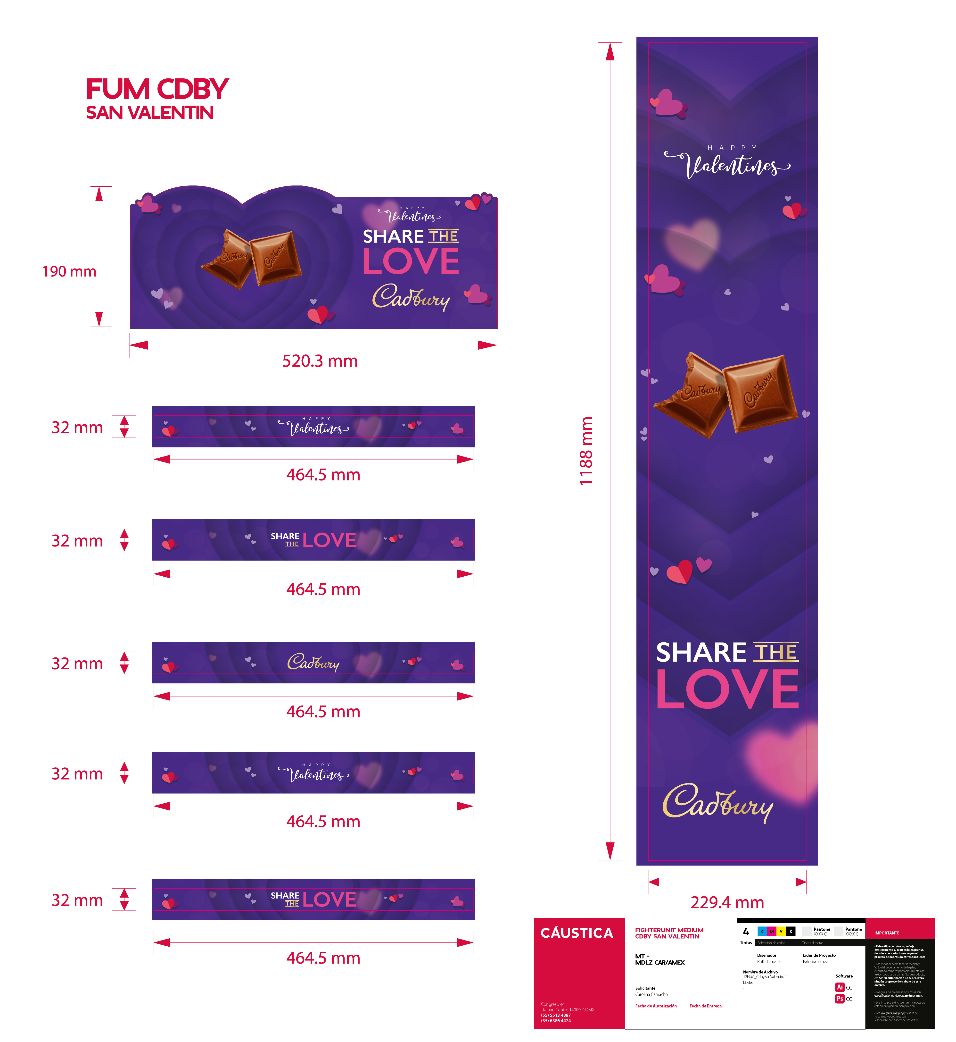
Fighter Unit Medium

Slide 14

Fighter Unit Slim

