Slide 1

Poster / Afiche
18 in

Slide 2
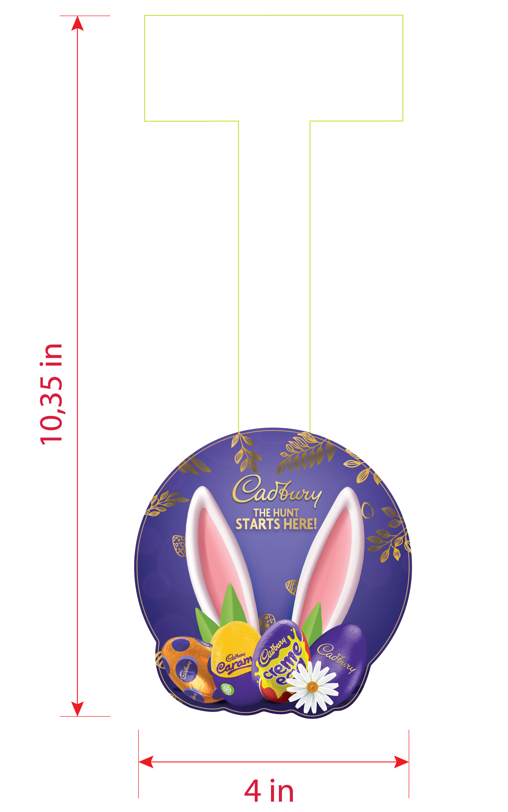
Dangler / Wobbler

Slide 3
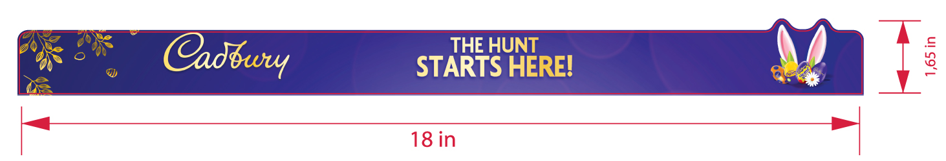
Dangler / Wobbler

Slide 4
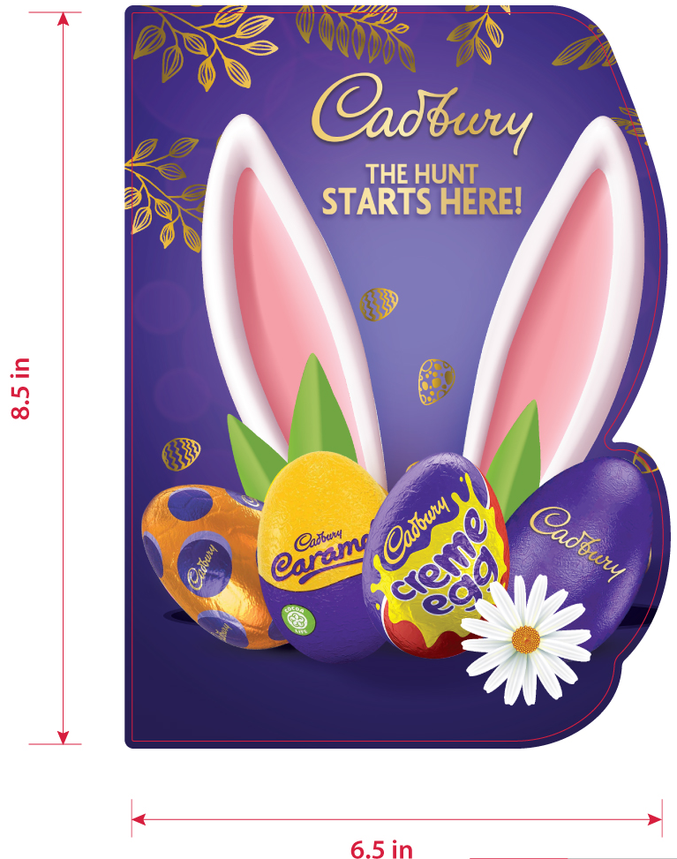
Stopper

Slide 5

Floor Sticker

Slide 6
Arco

Slide 7
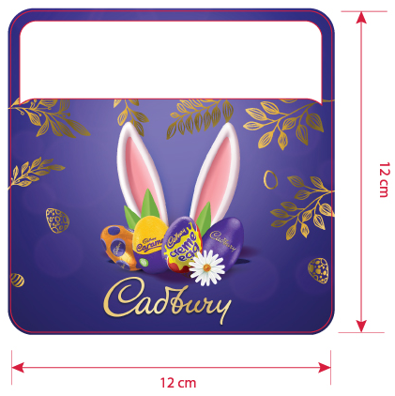
Price Talker

Slide 8
End Cap

Slide 9
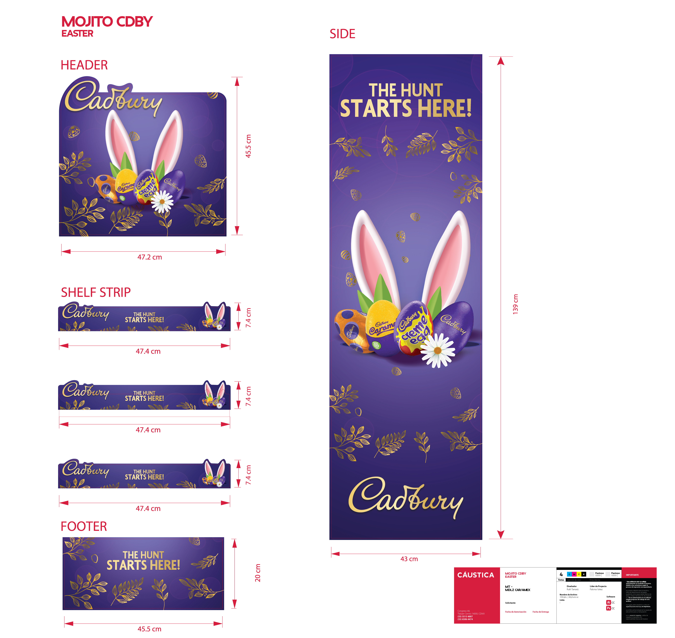
Mojito

Slide 10

Header 36 x 26 in

Slide 11
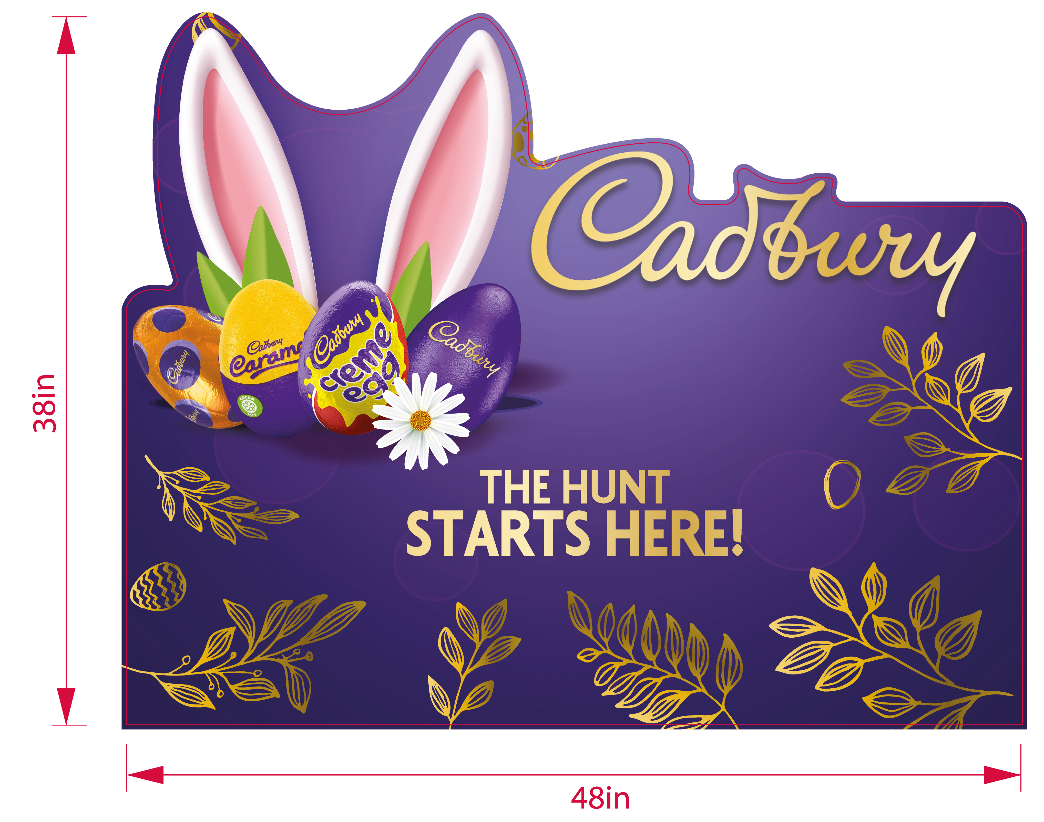
Header 48 x 38 in

Slide 12

Side panel

Slide 13
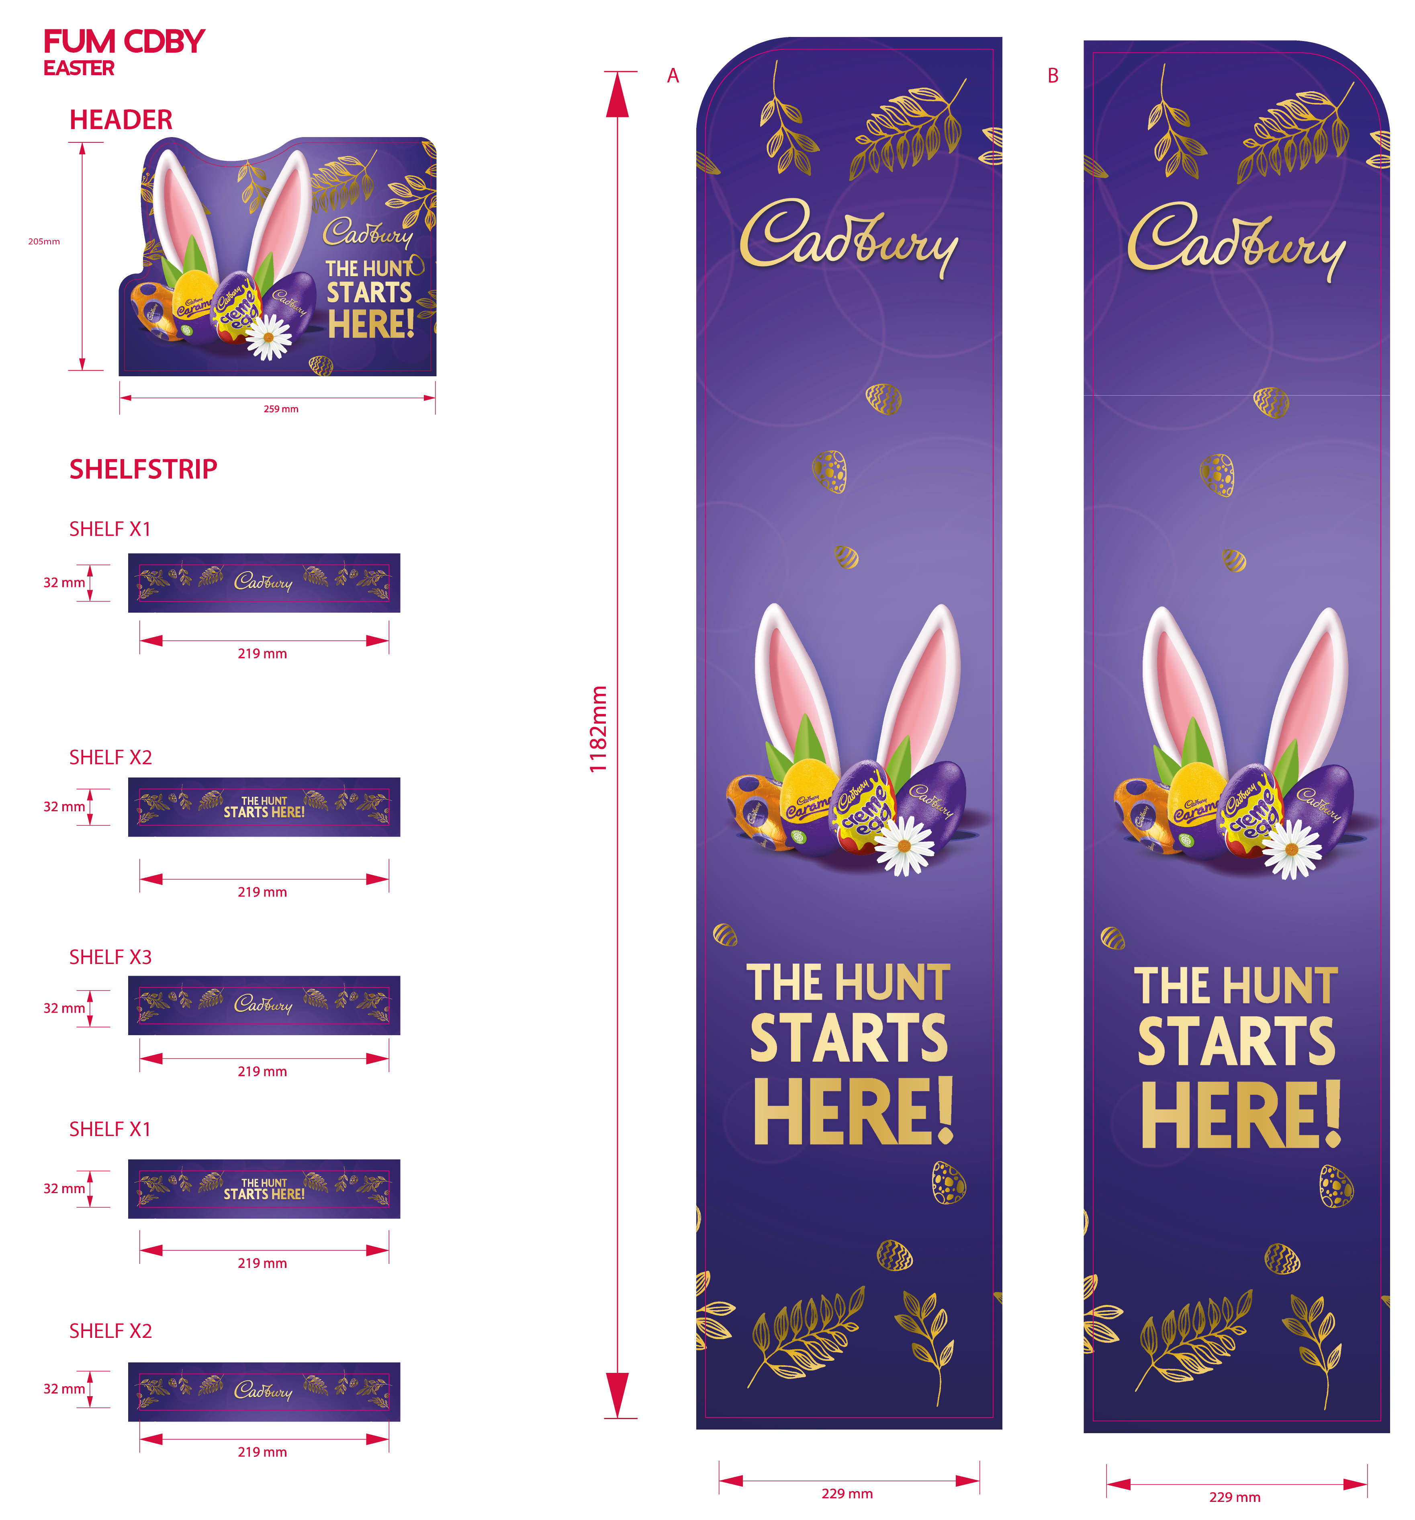
Fighter Unit Slim

Slide 14
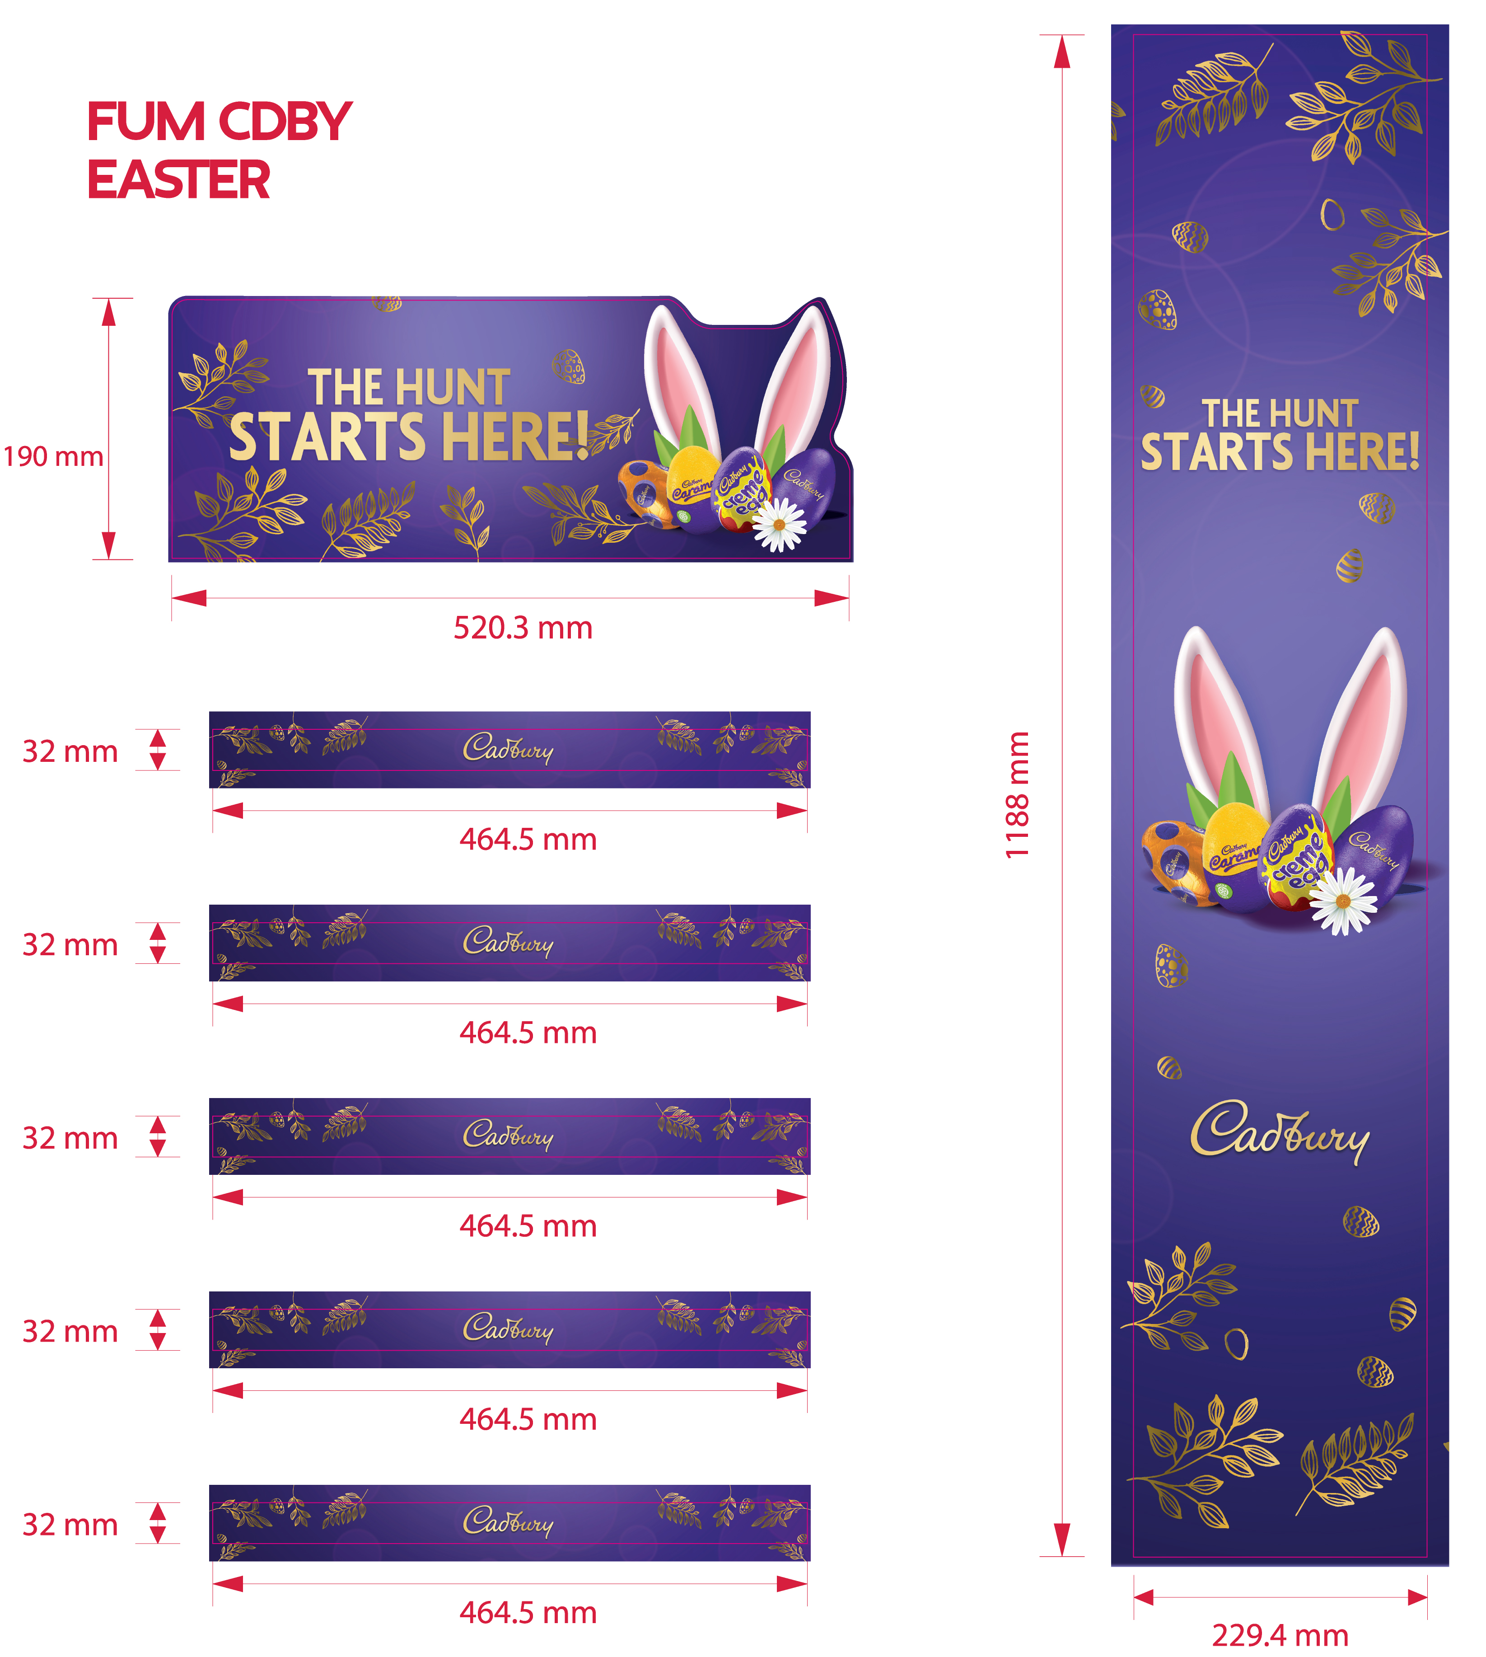
Fighter Unit Medium

Slide 15
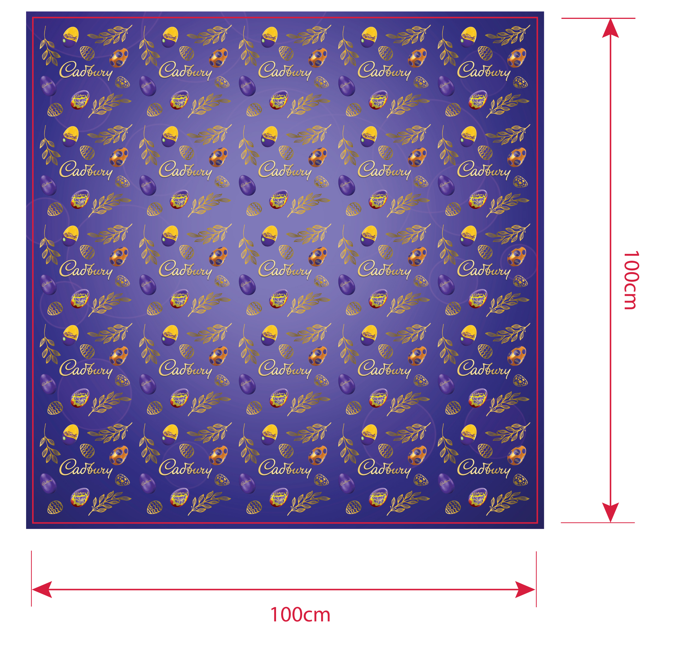
Papel góndola

